Slide 1

Study, implementation and simulation of OFDM and FBMC systems in Matlab

Slide 2
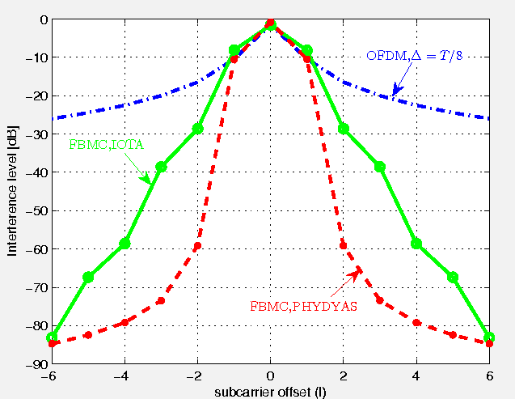

Modulation schemes candidates for 5G PHY layer

Slide 3
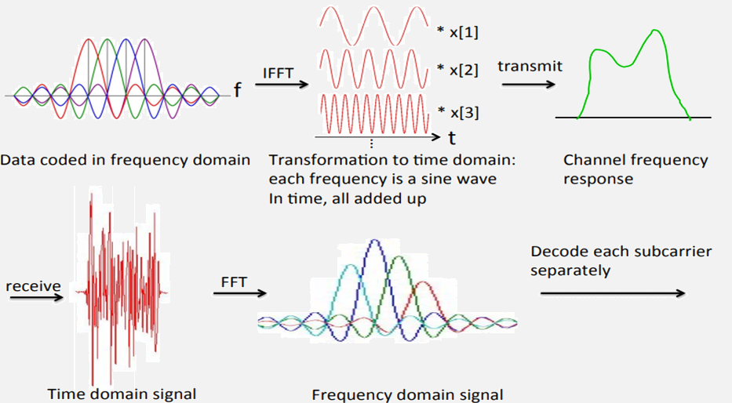
Orthogonal Frequency Division Multiplexing (OFDM)

Slide 4
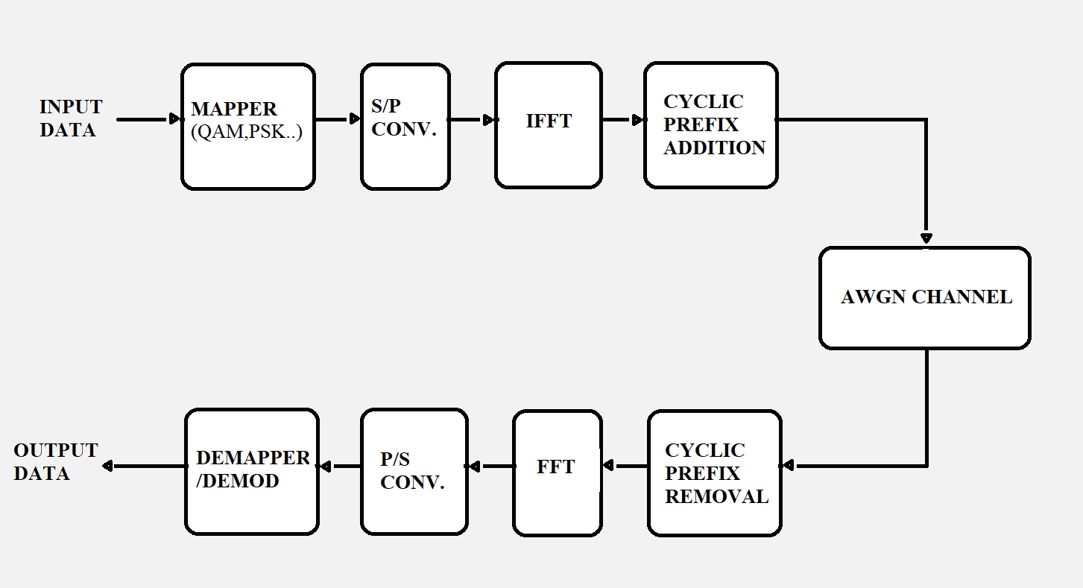
Orthogonal Frequency Division Multiplexing (OFDM)

Slide 5
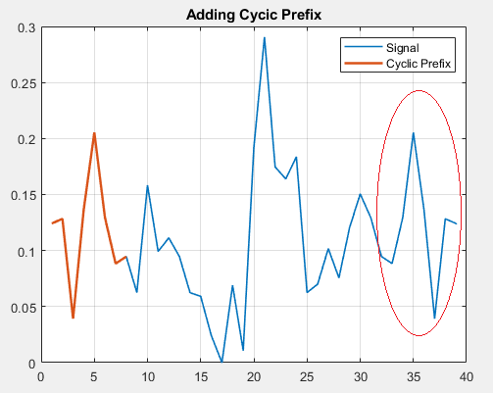
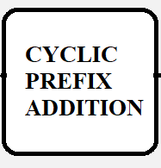
Implementation of an OFDM system
CP length = 8
N° FFT points = 32

Slide 6
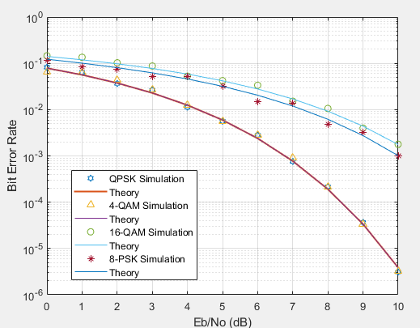
OFDM Simulations
BER vs SNR
N° of Subcarr. = 128
CP length = 32
AWGN Channel

Slide 7
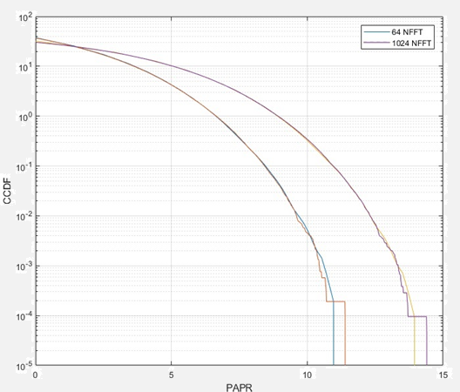

OFDM Simulations
CCDF vs PAPR
N° bits = 10^8
QPSK

Slide 8
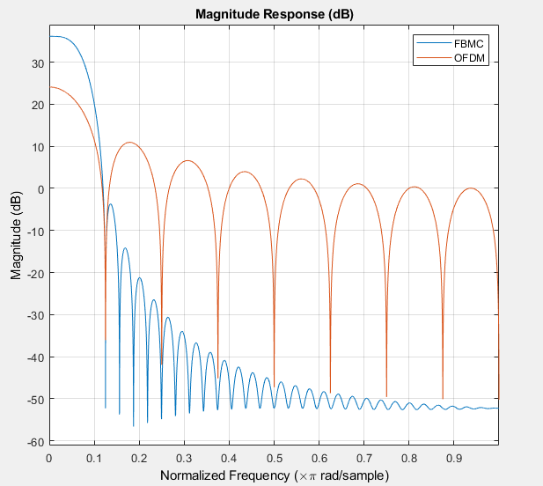
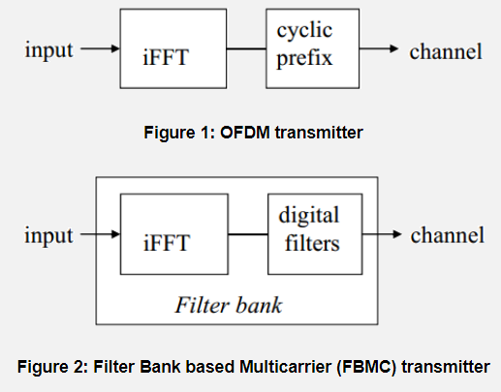
Filter Bank Multicarrier (FBMC)

Slide 9
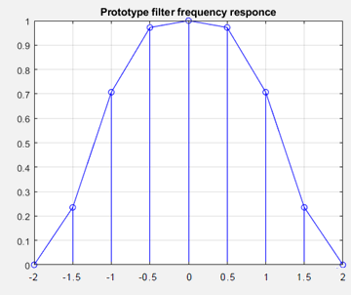
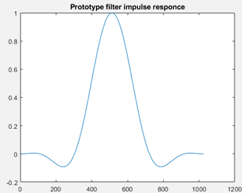
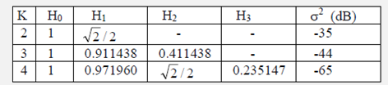

Prototype Filter Design (PHYDYAS)
K = 4
M = 256

Slide 10
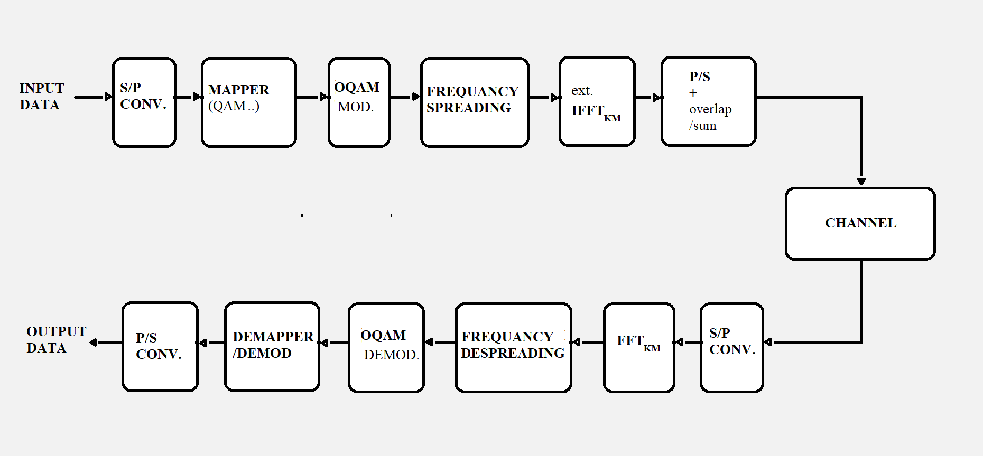
FBMC Frequency Spreading

Slide 11
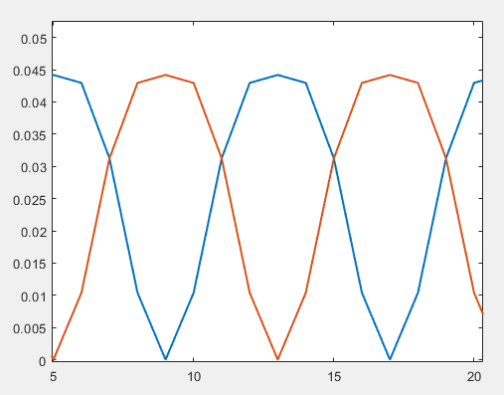
FBMC Frequency Spreading
REAL IMAG

Slide 12
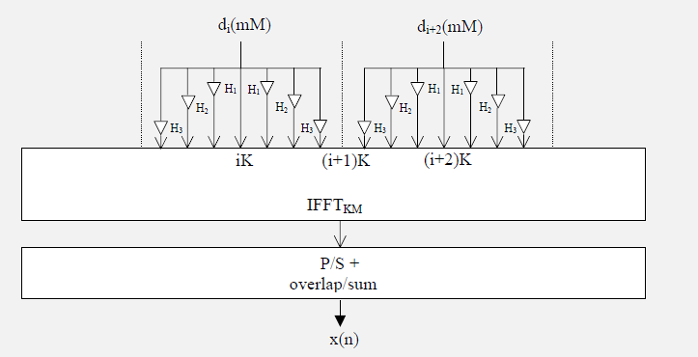
FBMC-FS Implementation
TX

Slide 13
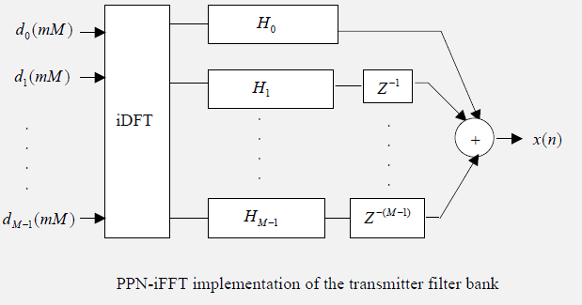
FBMC-PPN Implementation
TX

Slide 14
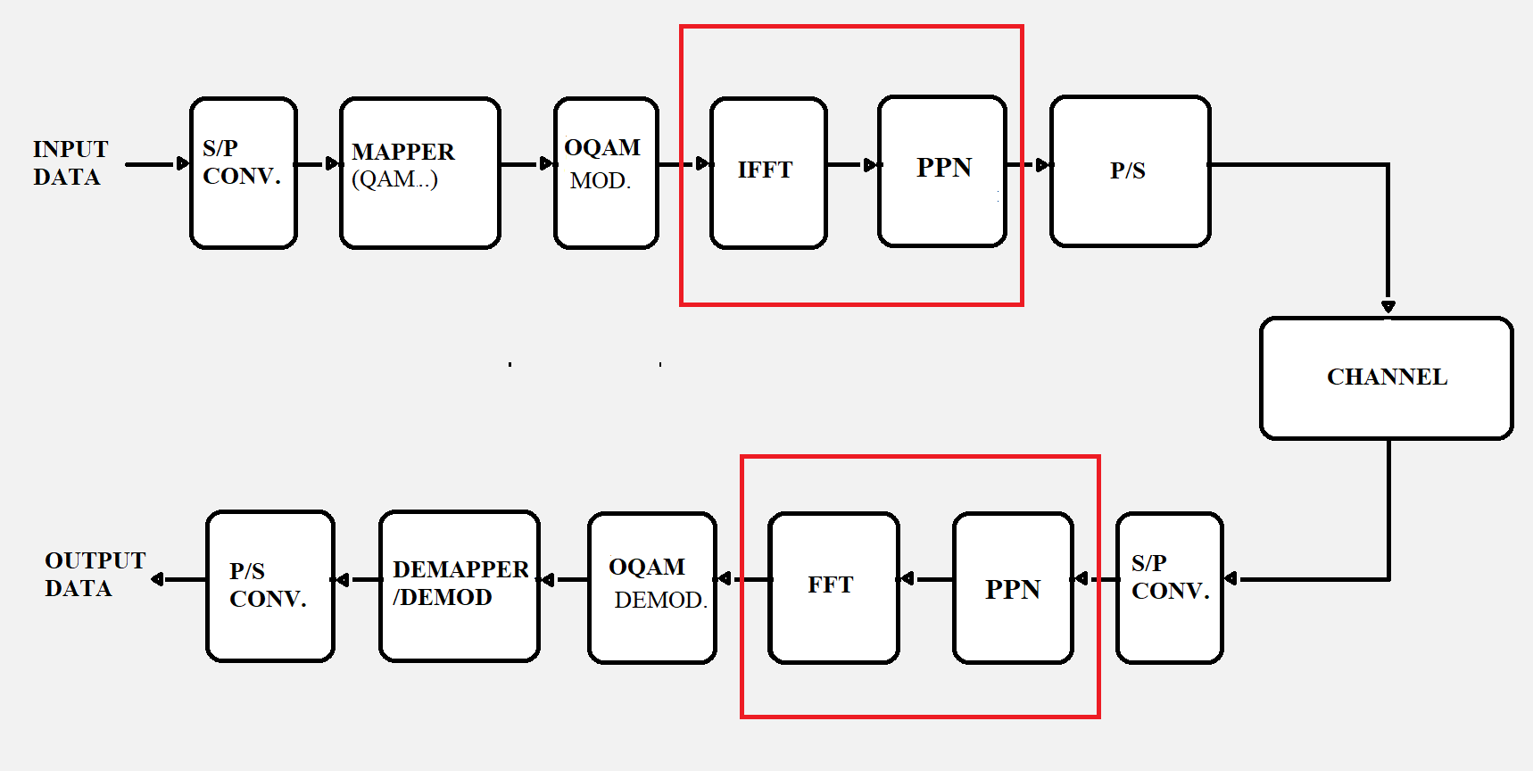
FBMC Polyphase Network

Slide 15
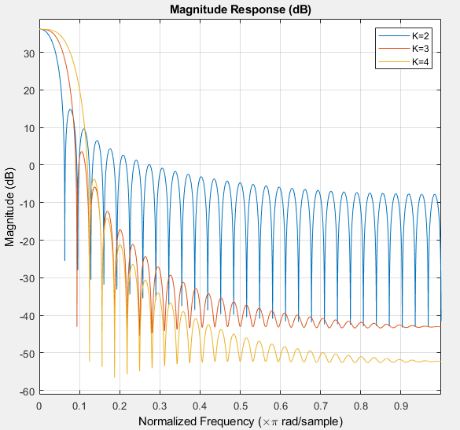

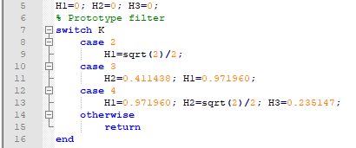
FBMC-OQAM Simluations

Slide 16
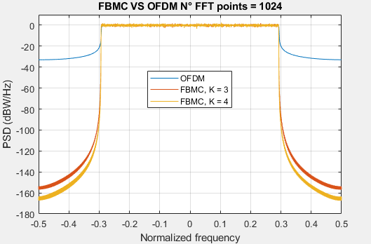
FBMC-OQAM vs OFDM
Power Spectral Density
M = 1024
212 Guard Band Length
100 Symbols
4-QAM

Slide 17
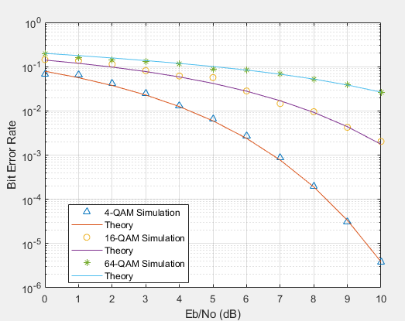
FBMC-OQAM Simluations
BER vs SNR
K= 4
M = 1024
212 Guard Band Length
AWGN Channel

Slide 18



CONCLUSIONS
The FBMC performs better than OFDM :
Very low out-of-band radiation
Higher spectrum efficiency
FBMC presents higher complexity compared to OFDM
Future work: implement coding, study of the behaviour of the system in Rayleigh channel

